Slide 1
Banking Laws & Practices—An Overview
Significance/Importance of Law
Law is to maintain rights, uphold justice
and redress wrongs. Law ensures public order, balance, harmony, peace and tranquility amongst the persons within the state and inter-states.

Slide 2
Law---Defined
Law signifies a rule of action and is applied to all kinds of action.
We are familiar with laws of nature, laws of mechanics. We are also conversant of laws of honor, laws of morality, law of God.

Slide 3
We are also listen about:
  Criminal Procedure Code. (Cr PC)
  Civil Procedure Code (CPC)
  Contract Act.
  Banking Companies Ordinance
  Sales Tax Act
  Companies Ordinance etc.
  Above are statutory enactments enforced by Courts of law, in a system/society.
  Hence law denotes entire body of legal principles prevailing in a particular system/society.

Slide 4
Some Concepts of Law:
“Law is not right alone or might alone, but a perfect combination between two.”
(Salmond)
“Law is the command of sovereign containing a common rules of life for his subject and obliging them to obedience”
    (John Erskin)
“Coercion is a weapon of law which law has forged, but it is not the basis of law”
  (De Motmorency)

Slide 5
Some Concepts of Law:
“ Law is the body of principles recognized or enforced by public or regular tribunals in the administration of justice”
(Pound)
“ Law is the system of rights and obligations which the state enforces”
(Green)

Slide 6
Some Concepts of Law:
“ You will not mistake my meaning or suppose that I depreciate one of the great human studies if I say that we cant learn law by learning law. If it is to be any thing more than just a technique it is to be so much more than itself, a part of history & sociology, a part of ethics and philosophy of life”
(Lord Radcaliff)

Slide 7
Classification of Law:
Imperative Law:
Three Essentials
General rules
Some authority behind this law.
It must be enforced by superior power.
Physical or Scientific Law:
Laws of motion, Gravity, Astrology

Slide 8
Moral laws
Law of morality, divine law.
Conventional Law
Based on agreements of interacting parties enforced at court of law e.g. Contract, Memorandum of Association.
Customary Law.
Rules, Customs followed for a long time.
Practical or Technical Law.
Law of engineering, architecture, photography.
International law
Rules, which govern sovereign States in their relations’ and conduct to one another.

Slide 9
Distinction Between Question of Law and Question of Fact
Criminal offence Versus Civil Liability.
Crime is an offence prohibited by law e-g; tress passing, theft, Murder etc.
Civil liability arises out of breach of obligations e-g; breach of contract.

Slide 10
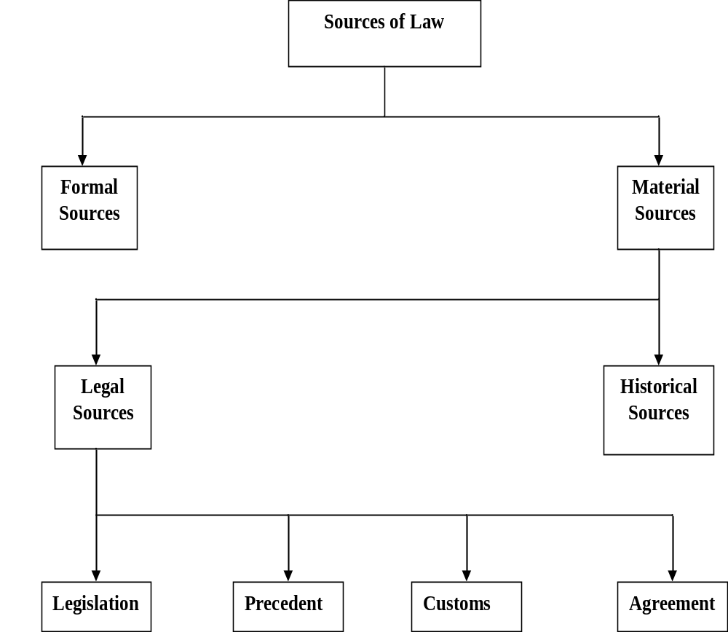

Slide 11
The Characteristics of State:
Certain Territory
Certain Functions
Some Population
A Political Society (must have a constitution)
A Government

Slide 12
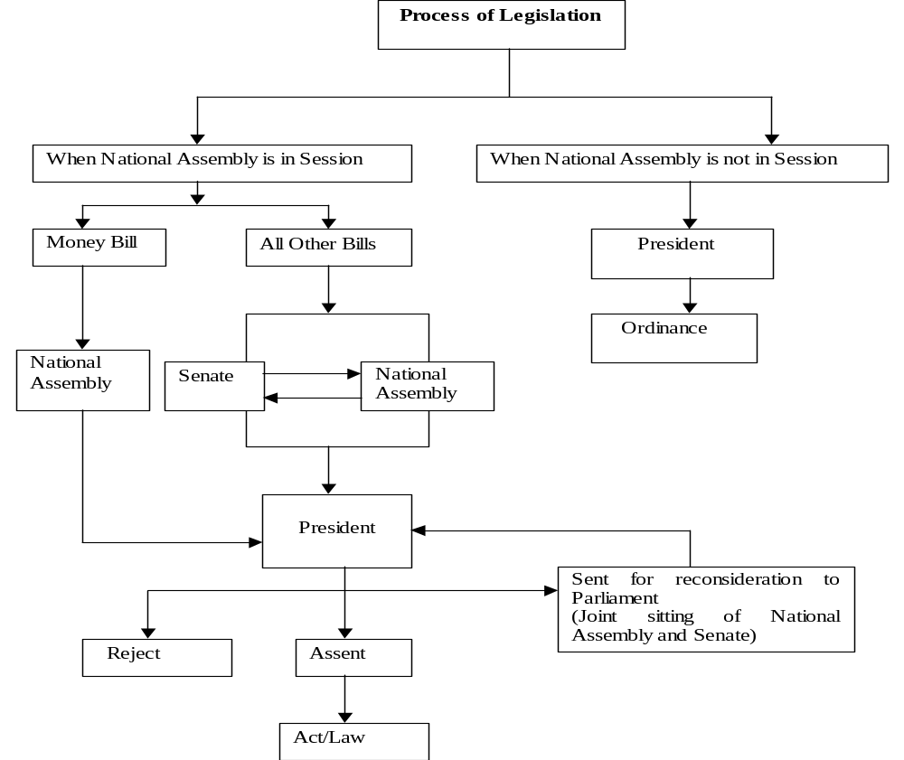

Slide 13
Substantive Law v/s Procedural Law
Substantive law defines rights.
This branch of law concerns the purposes and subject matter of litigations.
It is concerned with the objects of administration of justice.
It determine the process for remedies or procedure for enforcement of rights in courts.
It governs the process of litigation or relates to actions or proceedings, civil or criminal.
It means through which ends of justice are attained.

Slide 14
Substantive Law v/s Procedural Law
Its rules govern the conduct of the parties to the matter litigated.
Its relates to matter outside the courts.
Procedural law govern the relations between court and litigants.
It deals with affairs in the courts.

Slide 15
Sources of Law in Sharia
Sunnah
Ijtehad
Al-Quran

Slide 16
Sources of Law in Sharia:
Ijtehad---is the process for ascertaining the law. It is the use of intellectual exertion by an Islamic Jurist. (Mujtahid) to derive an answer to a legal question.
Rules for Exercising Ijtehad:
It must not be exercised on certain matters (for example, the existence of Allah)\
Mujtahid must be suitably qualified.
Recognized methods of Ijtehad to be followed by mujtahid.

Slide 17
Recognized Methods for Exercising Ijtehad
Ijma---is consensus of opinion based on consultation among Islamic Jurists (Imam, Faqeeh)
Qiyas---is analogical deduction. It is comparison of two situations with a view to evaluating one in the light of the other.

